Slide 1
Bayesian inference in simple linear regression
By Botao Liu and Shivam K C
Advised By Dr. Marian Frazier

Slide 2
Bayesian inference in simple Not so simple linear regression
By Botao Liu and Shivam K C
Advised By Dr. Marian Frazier
Notes:
Well, the teory behind linear regression in Bayesian land is not that simple. However, you are lucky that we are advised by Dr. Frazier as we are mostly going to dwell on big picture (conceptual stuffs) in our presentatiom

Slide 3

overview
Relationship Between Bayesian Inference and Frequentist Inference
Theory
Application
Summary

Slide 4
overview
Relationship Between Bayesian Inference and Frequentist Inference
Theory
Application
Summary

Slide 5
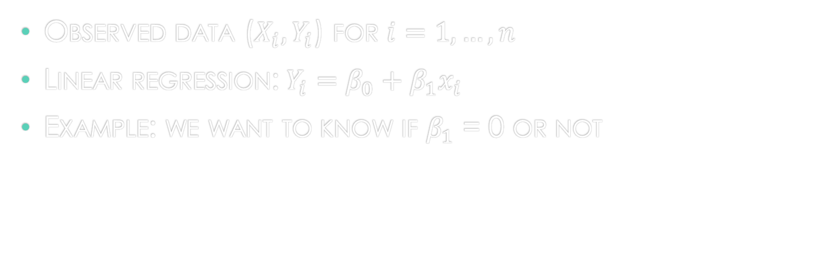
Fitting model in linear regression (frequentist land)
Observed data ($X_{i}, Y_{i}$) for $i=1,…,n$
Linear regression: $Y_{i}=β_{0}+β_{1}x_{i}$
Example: we want to know if $β_{1}$ = 0 or not
Notes:
Posterior distribution of $β_{1}$

Slide 6
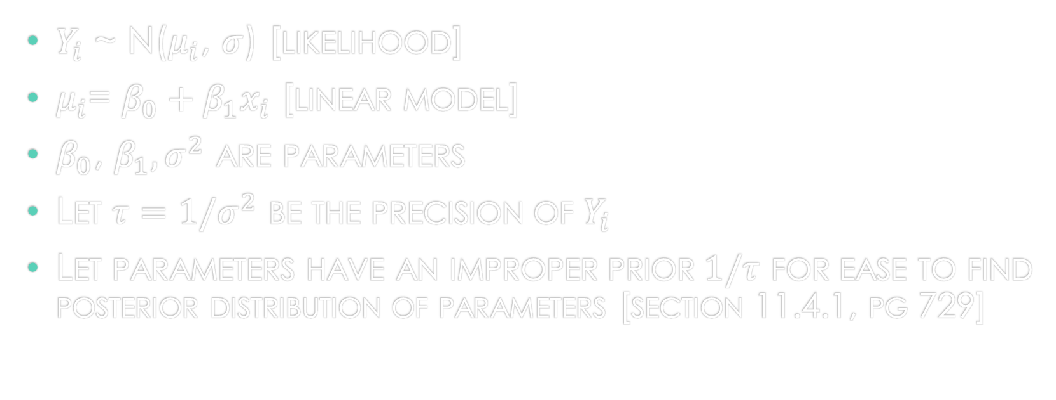
Fitting model in linear regression (Bayesian land)
$Y_{i}$ ~ N($μ_{i}$, $σ$) [likelihood]
$μ_{i}$= $β_{0}+β_{1}x_{i}$ [linear model]
$β_{0}$, $β_{1}, σ^{2}$ are parameters
Let $τ=1/σ^{2}$ be the precision of $Y_{i}$
Let parameters have an improper prior $1/τ$ for ease to find posterior distribution of parameters [section 11.4.1, pg 729]
Notes:
Example: we want to know if $β_{1}$ = 0 or not

Slide 7
overview
Relationship Between Bayesian Inference and Frequentist Inference
Theory
Application
Summary

Slide 8
theorem 11.4.1
Posterior distribution of where

Slide 9

theorem 11.4.1
Posterior distribution of where
Posterior distribution of $β_{0},β_{1},τ$

Slide 10

theorem 11.4.1
Posterior distribution of where
Posterior distribution of $β_{0},β_{1},τ$
Posterior of $β_{0}$, $β_{1}$, $τ$

Slide 11
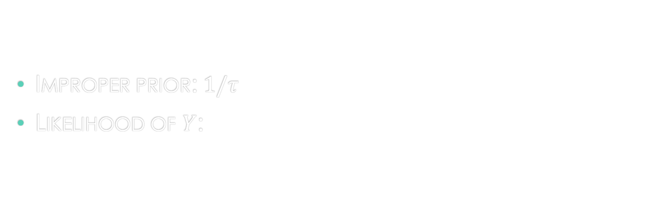
Proof of theorem 11.4.1
Improper prior: $1/τ$
Likelihood of $Y$:

Slide 12

Likelihood $×$ improper prior =

Slide 13

Likelihood $×$ improper prior =
From (11.3.29)

Slide 14

Likelihood $×$ improper prior =
From (11.3.29)
Product of likelihood and improper prior is proportional to posterior distribution in theorem 11.4.1

Slide 15
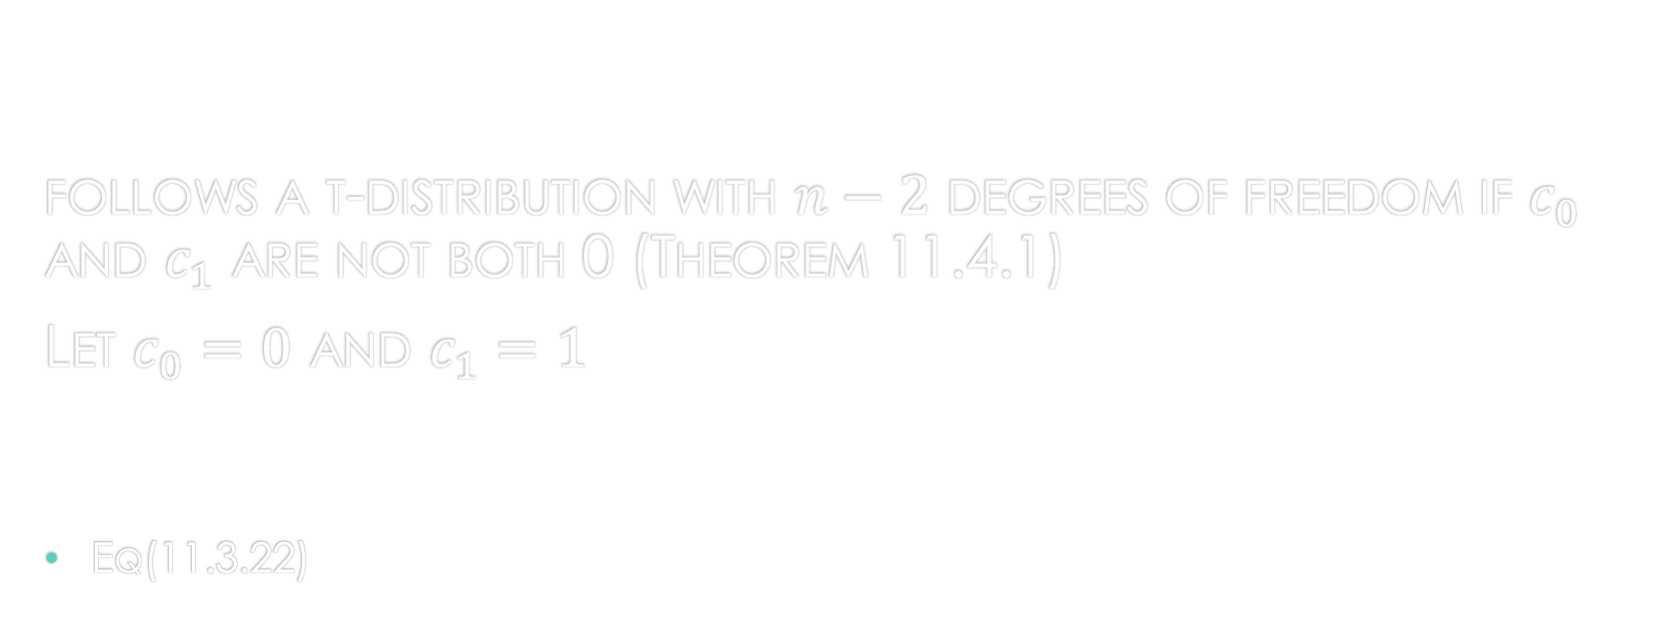
Test statistic for posterior distribution
follows a t-distribution with $n−2$ degrees of freedom if $c_{0}$ and $c_{1}$ are not both 0 (Theorem 11.4.1)
Let $c_{0}=0$ and $c_{1}=1$
Eq(11.3.22)
Notes:
According to equation 11.3.22 this is the test statistic for linear regression in frequentist land…

Slide 16
conclusion
If we use improper prior to build posterior distribution, then we will have similar inference for Bayesian and frequentist method:
We will have similar parameter (or slope) estimates
We will have similar credible interval and confidence interval

Slide 17
overview
Relationship Between Bayesian Inference and Frequentist Inference
Theory
Application
Summary

Slide 18
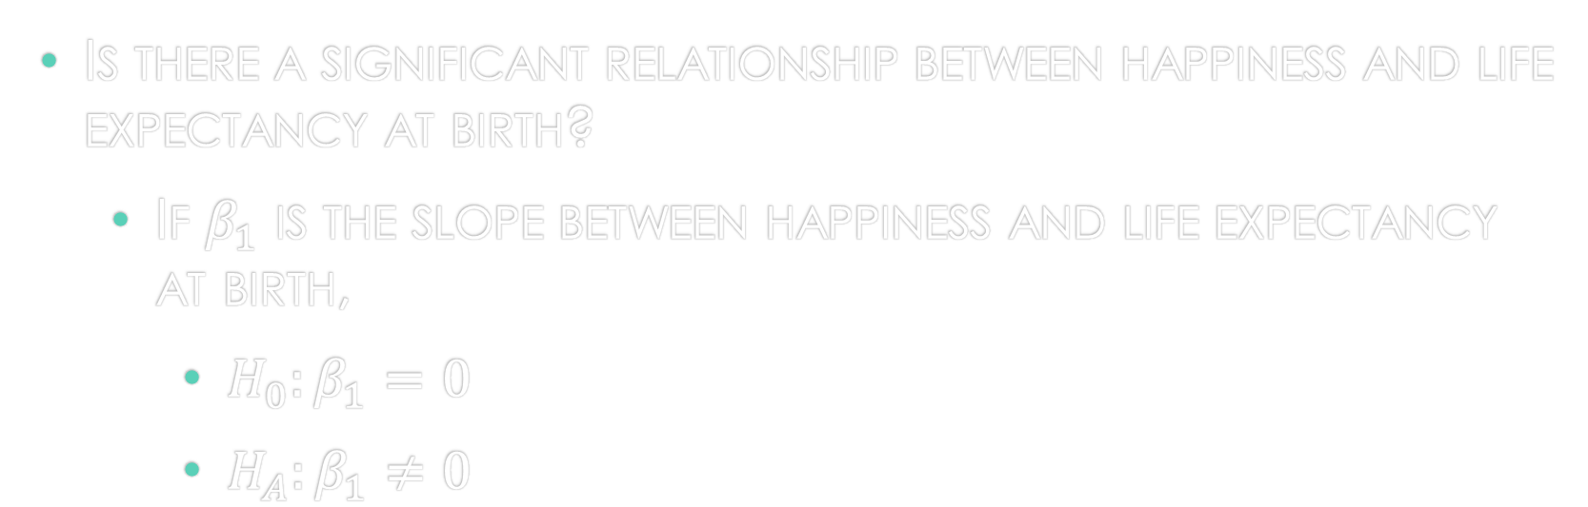
Research question
Is there a significant relationship between happiness and life expectancy at birth?
If $β_{1}$ is the slope between happiness and life expectancy at birth,
$H_{0}:β_{1}=0$
${H_{A}:β}_{1}≠0$

Slide 19
data
World Happiness Report
Produced by the UN
Survey of the state of global happiness
Ranks 156 countries
Notes:
global happiness that ranks 156 countries by how happy their citizens perceive themselves to be

Slide 20
variables
Response variable: Life Ladder (happiness)
Ranges from 2.5 to 8 (numeric)
Predictor: Life expectancy at birth
Ranges from 45 to 80 (numeric)
Notes:
Response variable: Life ladder. It is a happiness score that ranges from 2.5 to 8 assigned to a country. It is the national average of responses to a survey (Cantril Ladder) gotten by averaging the answers to a single number. Numeric
Predictor: Life expectancy at birth. are constructed based on data from the World Health Organization (WHO) Global Health Observatory data repository. numeric. Range 45 to 80

Slide 21
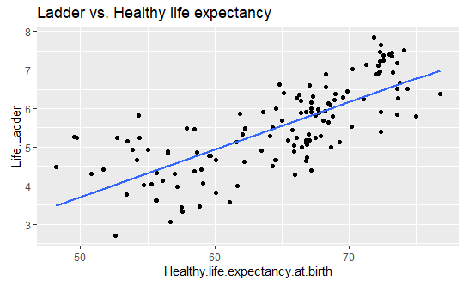
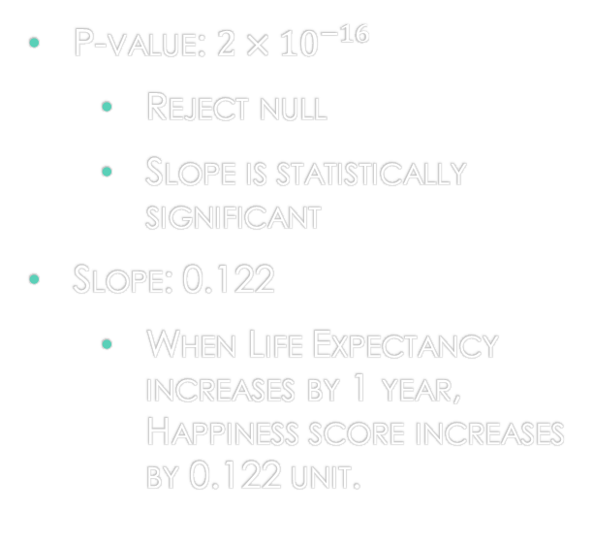
Simple Linear regression (frequentist)
P-value: $2×{10}^{−16}$
Reject null
Slope is statistically significant
Slope: 0.122
When Life Expectancy increases by 1 year, Happiness score increases by 0.122 unit.
Notes:
Eda: histogram of y; tables and shit but I need scatterplot…change later[cuz she doesn’t like it] 0.122…There is a sginifnciant evidence that null doesn’t equal to zero…0.1034256 0.141639[can talk about r squared if need more time]

Slide 22
Confidence interval
95% CI: (0.103, 0.142)
We are 95% confident that when Life Expectancy increases by 1 year, Happiness score increases by a value between 0.103 to 0.142 unit (inclusive).

Slide 23

Technology (fitting bayesian model)
We used MCMCregress from MCMCpack in R studio
This gives us slope estimate and credible interval
Notes:
To fit Bayesian linear regression model
Requried for testing our hypothesis. B0 is set to be uniform improper prior…and b0 is the mean of B1.

Slide 24
results
Slope: 0.123
When Life Expectancy increases by 1 year, Happiness score increases by 0.123 unit
Similar to frequentist slope (0.122)
95% Credible Interval: (0.103, 0.141)
There is a 95% probability that when Life Expectancy increases by 1 year, Happiness score will increase by a value between 0.103 to 0.141 unit (inclusive)
Similar to frequentist confidence interval (0.103, 0.142)
Notes:
0.1225
0.1034 and 0.1414
implying some effect of Life expectancy on happiness.

Slide 25
Testing hypothesis
95% Credible Interval: (0.103, 0.141)
The 95% credible interval for the slope does not overlap with 0
Thus, reject null
Slope is statistically significant
Notes:
0.1225
0.1034 and 0.1414
implying some effect of Life expectancy on happiness.

Slide 26
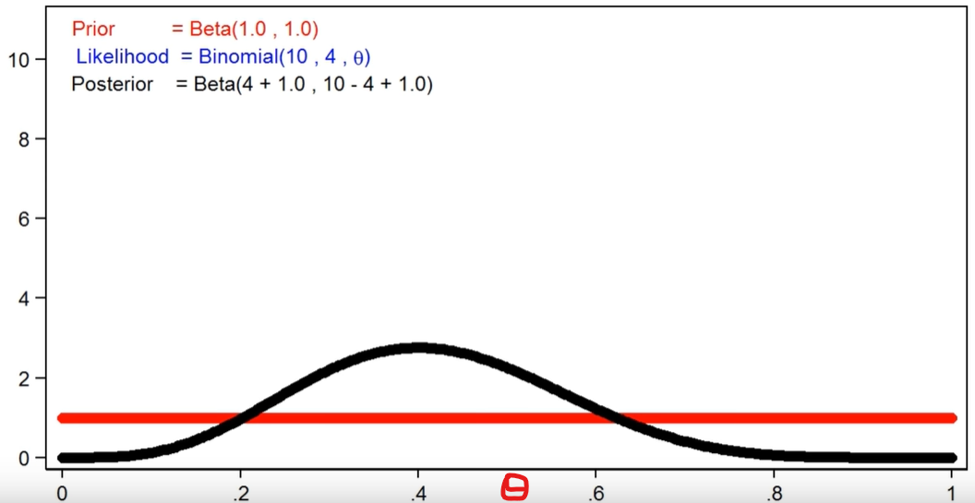
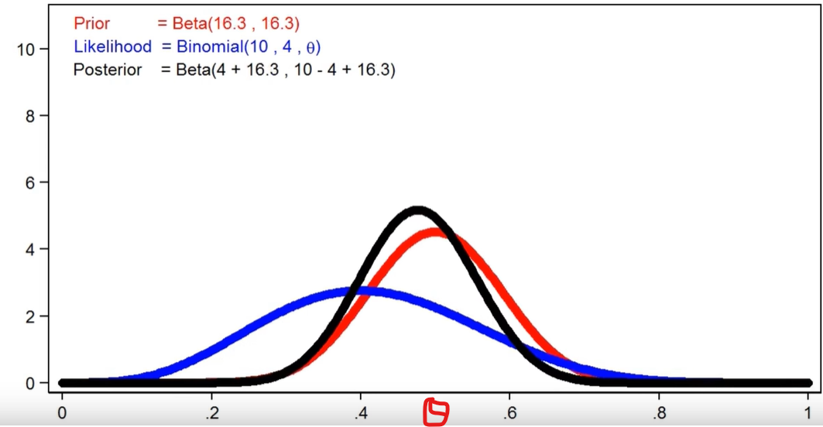
Effects of priors on Bayesian and Frequentist inference
Notes:
We have seen so far, when improper prior Bayesian and frequeqnstis inferences are the same…botao has proved it theoretically….lets take a look graphically..take an example of beta-binom conjcutgate family…

Slide 27
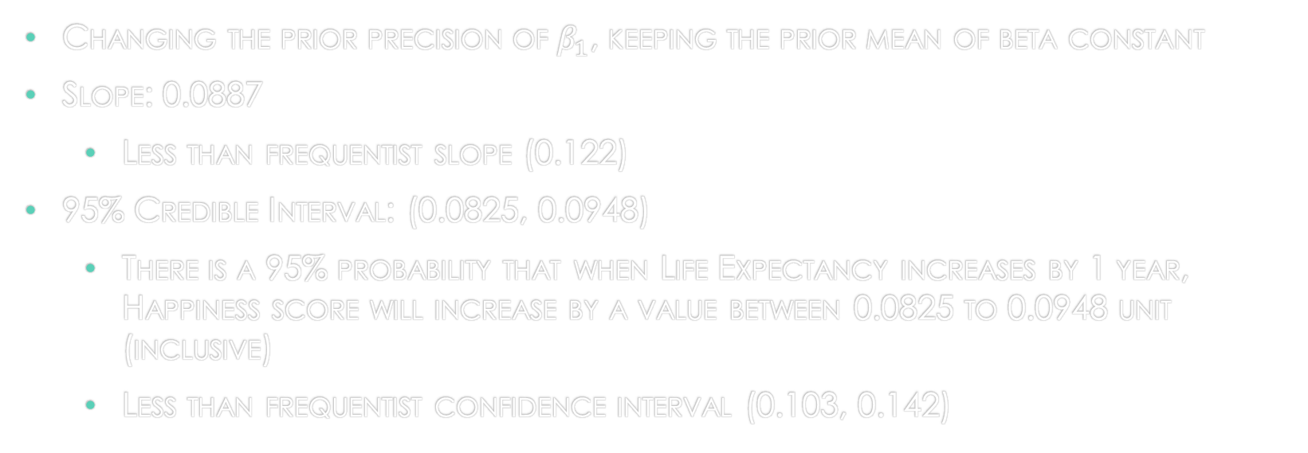
Example: Proper prior
Changing the prior precision of $β_{1}$, keeping the prior mean of beta constant
Slope: 0.0887
Less than frequentist slope (0.122)
95% Credible Interval: (0.0825, 0.0948)
There is a 95% probability that when Life Expectancy increases by 1 year, Happiness score will increase by a value between 0.0825 to 0.0948 unit (inclusive)
Less than frequentist confidence interval (0.103, 0.142)
Notes:
Difference between prope and improper priors? What happens when we use proper priors…
/
/
What if I have the figures? To show the differences…I can talk about it
What does prior precision look like in r code?
What does prior precison look like in our model?
0.08865
0.08247 and 0.09484

Slide 28
summary
Improper priors: Bayesian inference is similar to Frequentist
Proper priors: Bayesian inference differs from Frequentist
because posterior distribution is affected by prior and we make inference from it
Frequentist makes inference from Data
Notes:
It depends on the situation…if you have a proper prior and your Bayesian model is predicting better than frequentist then that means your prior is make the difference.
If frequentist model is predicting better than Bayesian then your intuition (prior) is hurting you…
If you have improper prior, you can use either Bayesian or frequentist….[ok]

Slide 29
conclusion
Bayesian or Frequentist?
Proper prior
If Bayesian is predicting better than frequentist, prior is making difference
Else, prior is hurting Bayesian prediction
Improper prior
Use frequentist
Notes:
It depends on the situation…if you have a proper prior and your Bayesian model is predicting better than frequentist then that means your prior is make the difference.
If frequentist model is predicting better than Bayesian then your intuition (prior) is hurting you…
If you have improper prior, you can use either Bayesian or frequentist….[ok]

Slide 30
Thank you!

